Slide 1

Chapter 3: Basic Data Types and Operations

Slide 2
Outline
Learning Outcomes
Data types, identifiers, variables and constants
Operation and data conversion
Input/output from console
At the end of this chapter, student should be able to:
Using the suitable type to represent data (C3)
Differentiate between variables and constants (C2)
Identify operators, operands and resultants (C2)
Use commands to read input and display output from/to console (C3)

Slide 3
Identifiers
Special symbols to name such programming entities as variables, constants, methods, classes and packages.
Examples in the previous simple program:
Circle - class name
radius - data name
area - data name

Slide 4
Identifiers
An identifier is a sequence of characters that consist of letters, digits, underscores (_), and dollar signs ($).
An identifier must begin with a letter, an underscore (_), or a dollar sign ($).
An identifier cannot:
be a reserved word, e.g. true, false, or null
start with a digit
contain a (blank) space
contain special characters, except _ and $
An identifier can be of any length.

Slide 5
Identifiers
Examples
Valid identifiers:
Invalid identifiers:
$2
ComputeArea
area
radius
showMessageDialog
payRate
salary
J42Stop
gross_salary
2A
*salary
gross-salary
class
public
String
income tax

Slide 6
Identifiers
Conventions for choosing identifier names:
Name according to what it represents
Consistent in the use of variable names
Consistent when using upper and lowercase characters
Variable name – lowercase, or mix-case
Constant name – uppercase (all caps)

Slide 7
Data
Data used in processing
Constant is a value that never changes during the processing of all instructions in a solution
Constant is given a location in memory and a name.
Variable – value may change during processing

Slide 8
Constants
Represents permanent data that never changes.
Use keyword (reserve word) final
final datatype CONSTANTNAME = VALUE;
final double PI = 3.14159;
final int SIZE = 3;

Slide 9
Constant
public class ComputeArea {
public static void main(String[] args) {
double radius, area;
final double PI = 3.14159;
radius = 20;
area = radius * radius * PI;
System.out.print(“The area for the circle of radius “ + radius + “ is ” + area);
}
}

Slide 10
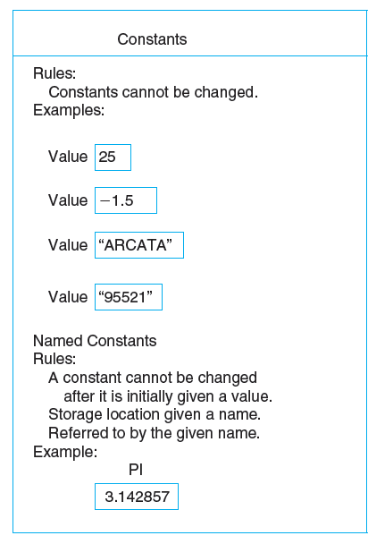
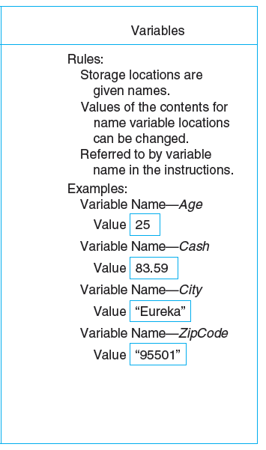
Constants and Variables on the Computer

Slide 11
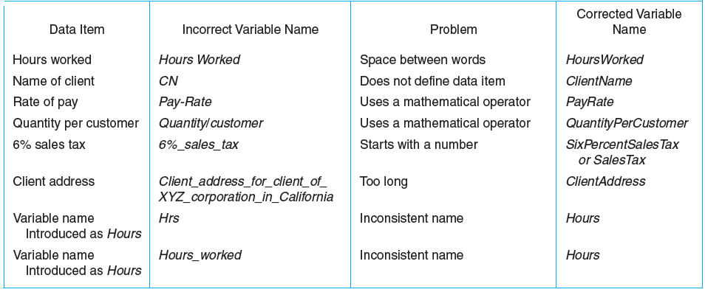
Variable Names

Slide 12
Rules for Naming and Using Variables
Name a variable according to what it represents.
Do not use spaces.
Start a variable name with a letter.
Do not use a dash or any other symbol that is used as a mathematical operator.

Slide 13
Rules for Naming and Using Variables
Consistent usage of variable name.
Consistent use of upper, lowercase characters in variable names
If the name consists of several words, concatenate all in one, use lowercase for the first word, and capitalize the first letter of each subsequent word in the name. For example, the variables radius and area, and the method computeArea.
Use naming convention specified by your company

Slide 14
Naming Conventions, cont.
Choose meaningful and descriptive names
Constants:
Capitalize all letters in constants, and use underscores to connect words. For example, the constant PI and MAX_VALUE
Class names:
Capitalize the first letter of each word in the name. For example, the class name ComputeArea.

Slide 15
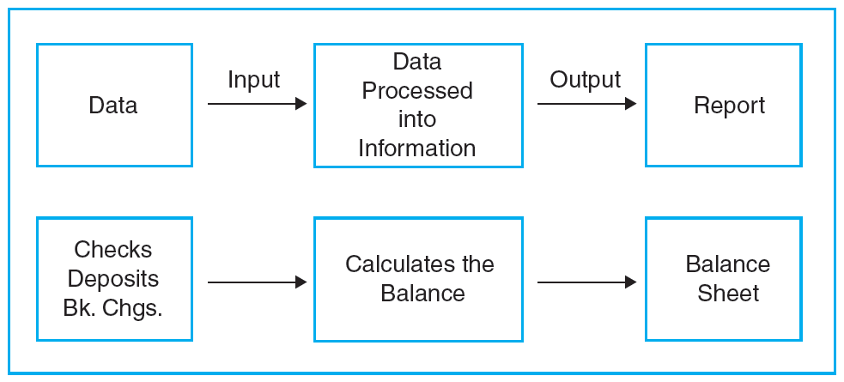
Processing Data—How a Computer Balances a Checkbook

Slide 16
Data Types
Data are unorganized facts
Goes as input and is processed to produce output, information
Computers must be told the data type of each variable and constant
Three common types: numeric, character, and logical
Other data types: date data type and user-defined data types

Slide 17
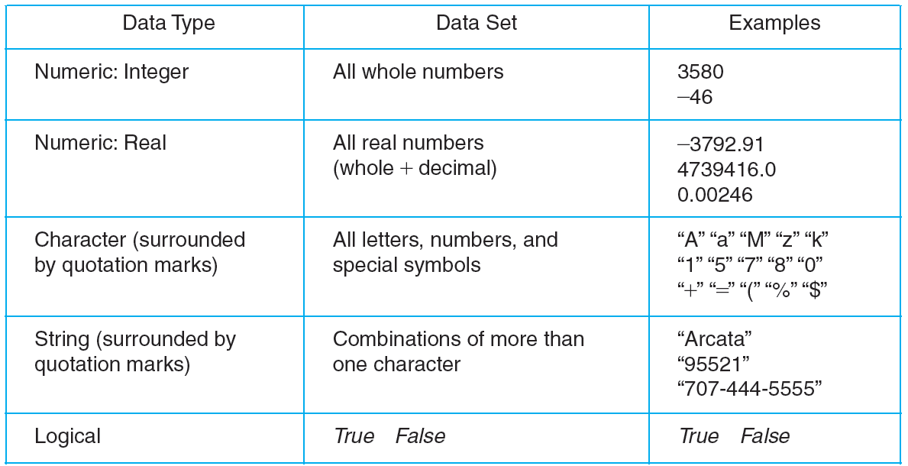
Data Types and Their Data Sets

Slide 18
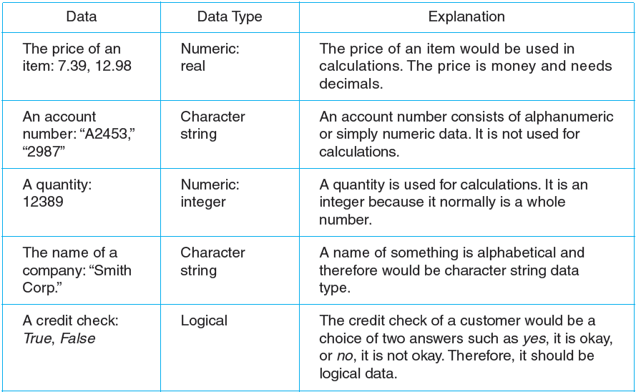
Examples of Data Types

Slide 19
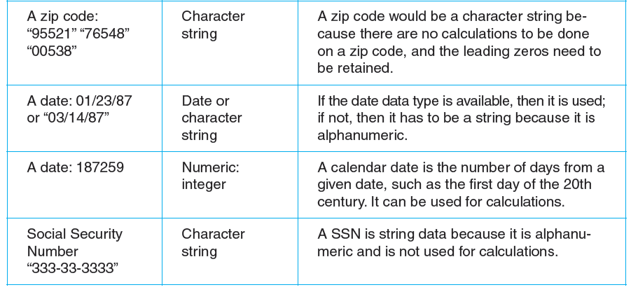
Examples of Data Types

Slide 20
Declaring Variables
int x; // Declare x to be an
// integer variable;
double radius; // Declare radius to
// be a double variable;
char a; // Declare a to be a
// character variable;

Slide 21
Assignment Statements
x = 1; // Assign 1 to x;
radius = 1.0; // Assign 1.0 to radius;
a = 'A'; // Assign 'A' to a;

Slide 22
Declaring Variables
Example:
Declare all variables involved in the following problem:
Find the sum and difference of two integer numbers.
int number1;
int number2;
int sum;
int difference;

Slide 23
Declaring and Initializing in One Step
From previous example:
int x;
double radius;
char a;
x = 1;
radius = 1.0;
a = ‘A’;
int x = 1;
double radius = 1.0;
char a = ‘A’;

Slide 24
Declaring and Initializing in One Step
Example:
Declare all variables involved in the following problem:
Find the sum and difference of two integer numbers where the value of the first integer is 20 and the second integer is 35.
int number1 = 20;
int number2 = 35;
int sum = number1 + number2;
int difference = number1 – number 2;

Slide 25
Numeric Data Types
Integers (in Java):
Floating-point numbers:
byte
short
int
long
Examples:
3
5876
float
double
Examples:
0.3
4.00
2.57
0.0095

Slide 26
Numerical Data Types
byte 8 bits
short 16 bits
int 32 bits
long 64 bits
float 32 bits
double 64 bits

Slide 27
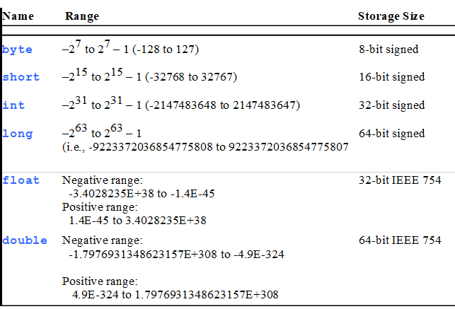
Numerical Data Types

Slide 28

A Simple program

Slide 29
Simple Program Structure
Class name
public class ____________ {
public static void main(String[] args) {
//Steps to be performed
}
}

Slide 30
Writing Simple Programs
Algorithm:
Read the radius
Compute the area using the following formula:
area = radius x radius x pi
Display the area

Slide 31
Writing Simple Programs
public class Circle {
public static void main(String[] args) {
//Step 1: Read the radius
//Step 2: Compute area
//Step 3: Display the area
}
}
What are the variables involved?

Slide 32
Writing Simple Programs
public class Circle {
public static void main(String[] args) {
double radius;
double area;
//Step 1: Read the radius
//Step 2: Compute area
//Step 3: Display the area
}
}

Slide 33
Writing Simple Programs
public class Circle {
public static void main(String[] args) {
double radius;
double area;
//Step 1: Read the radius (assign a value)
radius = 20.0;
//Step 2: Compute area
//Step 3: Display the area
}
}

Slide 34
Writing Simple Programs
public class Circle {
public static void main(String[] args) {
double radius;
double area;
//Step 1: Read the radius (assign a value)
radius = 20.0;
//Step 2: Compute area
area = radius * radius * 3.14159;
//Step 3: Display the area
}
}

Slide 35
Writing Simple Programs
public class Circle {
public static void main(String[] args) {
double radius;
double area;
//Step 1: Read the radius (assign a value)
radius = 20.0;
//Step 2: Compute area
area = radius * radius * 3.14159;
//Step 3: Display the area
System.out.println(area);
}
}

Slide 36
Writing Simple Programs
public class Circle {
public static void main(String[] args) {
double radius;
double area;
radius = 20.0;
area = radius * radius * 3.14159;
System.out.println(“The area for the circle of radius ” + radius + “ is ” + area);
}
}

Slide 37
operators

Slide 38
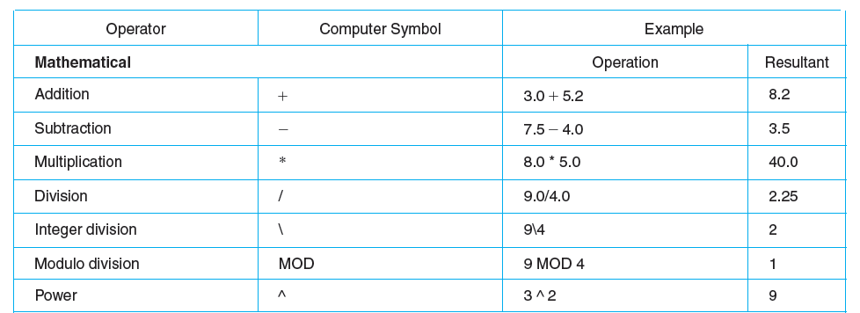
Operators and Their Computer Symbols

Slide 39
Remainder Operator
Note: Remainder is very useful in programming.
For example, an even number % 2 is always 0 and an odd number % 2 is always 1. So you can use this property to determine whether a number is even or odd. Suppose you know January 1, 2005 is Saturday, you can find that the day for February 1, 2005 is Tuesday using the following expression:


Slide 40
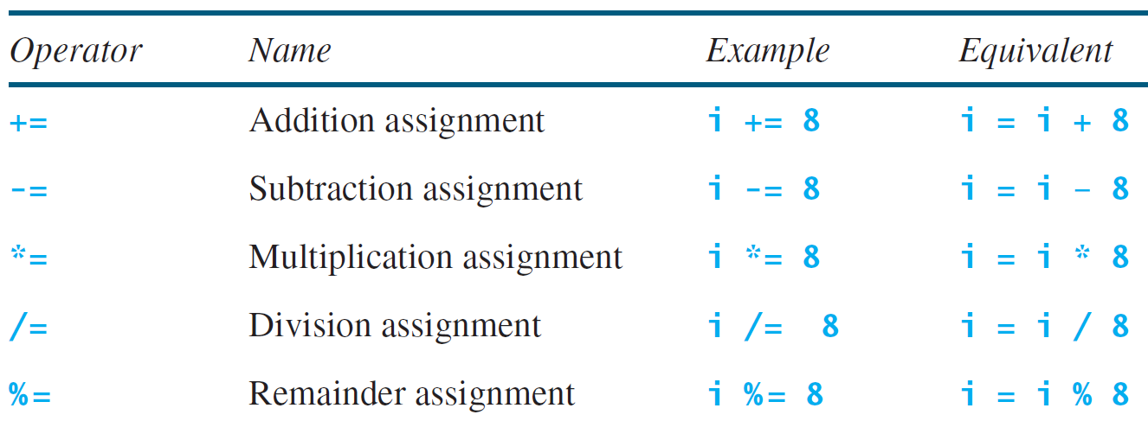
Augmented Assignment Operators

Slide 41
Increment and Decrement Operators
Operator | Name | Description
++var | preincrement | The expression (++var) increments var by 1 and evaluates to the new value in var after the increment.
var++ | postincrement | The expression (var++) evaluates to the original value in var and increments var by 1.
--var | predecrement | The expression (--var) decrements var by 1 and evaluates to the new value in var after the decrement.
var-- | postdecrement | The expression (var--) evaluates to the original value in var and decrements var by 1.

Slide 42
Increment and Decrement Operators, cont.
int num = 28;
num++;
++num;
--num;
num--;
int x = 28;
int y;
y = 2 * x++; //--> (2*28)+1 --> 57
y = 2 * (++x); //--> 2 * (28+1) --> 58
//Better to write separately:
x++; // x --> 29
y = 2 * x; // y --> 58

Slide 43
Increment and Decrement Operators, cont.
int i = 10;
int newNum = 10 * i++;
Same effect as
int newNum = 10 * i;
i = i + 1;
int i = 10;
int newNum = 10 * (++i);
Same effect as
i = i + 1;
int newNum = 10 * i;

Slide 44
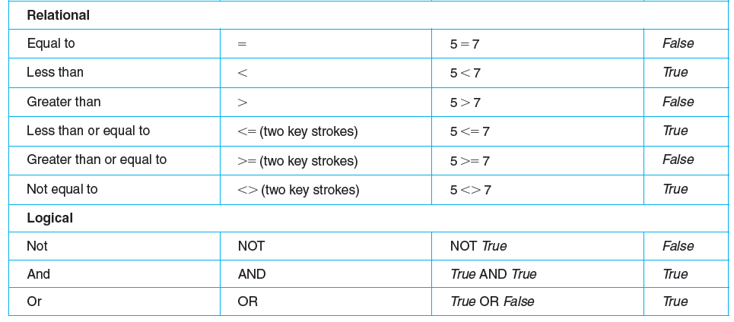
Operators and Their Computer Symbols

Slide 45
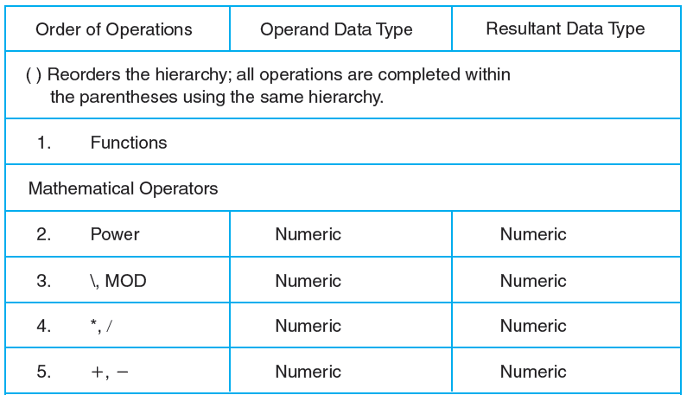
Hierarchy of Operations

Slide 46
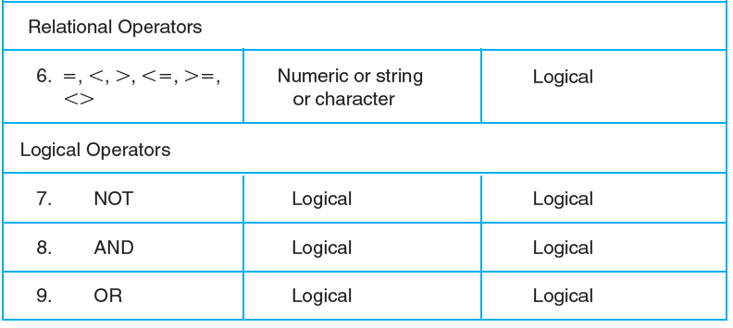
Hierarchy of Operations

Slide 47
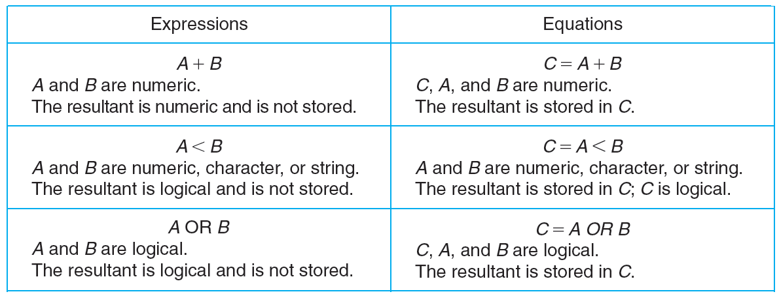
Expressions and Equations

Slide 48
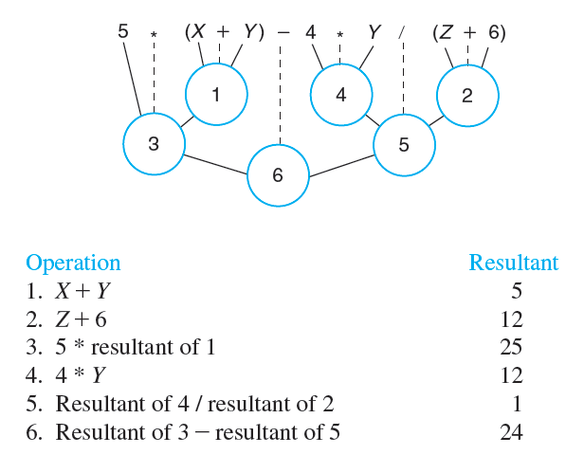
Evaluating a Mathematical Expression
X = 2
Y = 3
Z = 6

Slide 49
Operator Precedence
How to evaluate 3 + 4 * 4 > 5 * (4 + 3) – 1?

Slide 50
Introducing Programming with an Example
// This program computes the area of the circle.
public class Circle {
/** Main method */
public static void main(String[] args) {
double radius;
double area;
// Assign a radius
radius = 20.0;
// Compute area
area = radius * radius * 3.14159;
// Display results
System.out.println("The area for the circle of radius " + radius + " is " + area);
}
}

Slide 51
Trace a Program Execution
animation
allocate memory for radius
public class ComputeArea {
/** Main method */
public static void main(String[] args) {
double radius;
double area;
// Assign a radius
radius = 20.0;
// Compute area
area = radius * radius * 3.14159;
// Display results
System.out.println("The area for the circle of radius " + radius + " is " + area);
}
}
radius
no value

Slide 52
Trace a Program Execution
animation
public class ComputeArea {
/** Main method */
public static void main(String[] args) {
double radius;
double area;
// Assign a radius
radius = 20.0;
// Compute area
area = radius * radius * 3.14159;
// Display results
System.out.println("The area for the circle of radius " + radius + " is " + area);
}
}
memory
radius
no value
area
no value
allocate memory for area

Slide 53
Trace a Program Execution
animation
public class ComputeArea {
/** Main method */
public static void main(String[] args) {
double radius;
double area;
// Assign a radius
radius = 20.0;
// Compute area
area = radius * radius * 3.14159;
// Display results
System.out.println("The area for the circle of radius " + radius + " is " + area);
}
}
assign 20.0 to radius
radius
20.0
area
no value

Slide 54
Trace a Program Execution
animation
public class ComputeArea {
/** Main method */
public static void main(String[] args) {
double radius;
double area;
// Assign a radius
radius = 20.0;
// Compute area
area = radius * radius * 3.14159;
// Display results
System.out.println("The area for the circle of radius " + radius + " is " + area);
}
}
memory
radius
20.0
area
1256.636
compute area and assign it to variable area

Slide 55

Trace a Program Execution
animation
public class ComputeArea {
/** Main method */
public static void main(String[] args) {
double radius;
double area;
// Assign a radius
radius = 20.0;
// Compute area
area = radius * radius * 3.14159;
// Display results
System.out.println("The area for the circle of radius " + radius + " is " + area);
}
}
memory
radius
20.0
area
1256.636
print a message to the console

Slide 56
Reading Input from the Console
1. Create a Scanner object
Scanner input = new Scanner(System.in);
2. Use the method nextDouble() to obtain to a double value. For example,
System.out.print("Enter a double value: ");
Scanner input = new Scanner(System.in);
double d = input.nextDouble();
ComputeAreaWithConsoleInput
Run
ComputeAverage
Run

Slide 57
Reading Numbers from the Keyboard
Scanner input = new Scanner(System.in);
int value = input.nextInt();

Slide 58
Getting Input Using Scanner
// Example 2.1 Computing the Area of a Circle
public class Circle {
/** Main method */
public static void main(String[] args) {
double radius;
double area;
// Assign a radius
radius = 20.0;
// Compute area
area = radius * radius * 3.14159;
// Display results
System.out.println("The area for the circle of radius " + radius + " is " + area);
}
}
import java.util.Scanner;
Create scanner object
// Read radius from user
Scanner scanner = new Scanner(System.in);
System.out.print("Enter radius: ");
radius = scanner.nextDouble();
Prompt user
Read data

Slide 59
Getting Input Using Scanner
import java.util.Scanner;
public class ReadInput {
public static void main(String[] args) {
Scanner scanner = new Scanner(System.in);
// Read input from user
System.out.print("Enter radius: ");
double radius = scanner.nextDouble();
System.out.print("Enter an integer number: ");
int number = scanner.nextInt();
// …. More statements…
}
}
Create scanner object ONCE, can be used many times

Slide 60
Exercise
2. Write a program that reads a number in feet, converts it to meters, and displays the result. One foot is 0.305 meters.

Slide 61

The File Class
The File class is intended to provide an abstraction that deals with most of the machine-dependent complexities of files and path names in a machine-independent fashion. The filename is a string. The File class is a wrapper class for the file name and its directory path.

Slide 62
The File class
Create File object
Syntax:
java.io.File fileObject = new java.io.File(filename);
Example:
java.io.File file = new java.io.File (“score.txt”);
Check whether file already created or not
Syntax:
file.exists()
Example:
while (file.exists()) {
}
Delete the file (will return true if the deletion succeed)
if (file.delete())
System.out.println(“File deleted”);

Slide 63
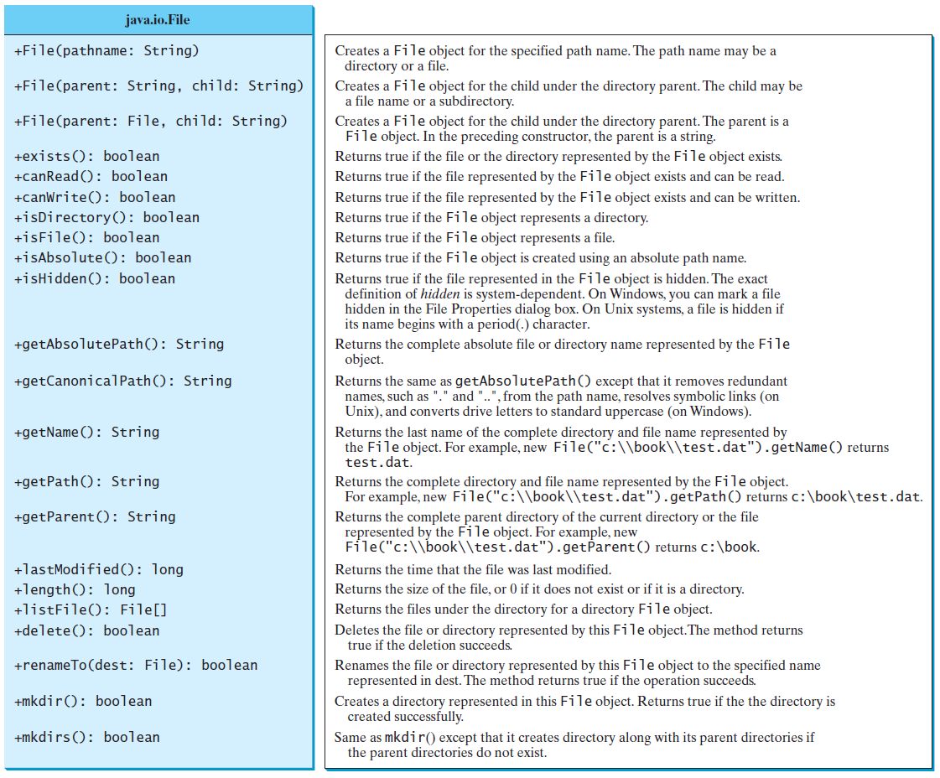
Obtaining file properties and manipulating file

Slide 64
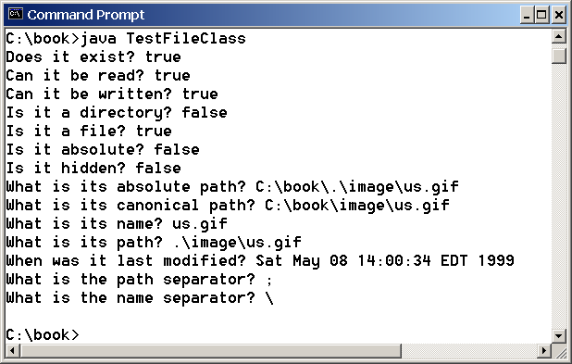
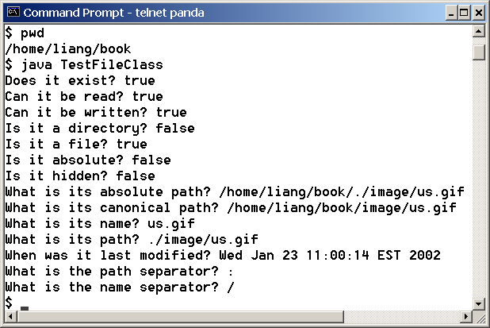
Problem: Explore File Properties
Objective: Write a program that demonstrates how to create files in a platform-independent way and use the methods in the File class to obtain their properties. The following figures show a sample run of the program on Windows and on Unix.
TestFileClass
Run

Slide 65
Text I/O
A File object encapsulates the properties of a file or a path, but does not contain the methods for reading/writing data from/to a file. In order to perform I/O, you need to create objects using appropriate Java I/O classes. The objects contain the methods for reading/writing data from/to a file. This section introduces how to read/write strings and numeric values from/to a text file using the Scanner and PrintWriter classes.

Slide 66
Writing to a Text File
Class PrintWriter is the preferred stream class for writing to a text file.
PrinterWriter has methods print and println.
Create a stream to associate the output stream with the file
java.io.File file = new java.io.File(“score.txt”);
PrintWriter output = new PrintWriter(file);

Slide 67
Writing Data Using PrintWriter
WriteData
Run

Slide 68
import java.io.*;
import java.util.*;
public class WriteDataToFile{
public static void main(String[] args) throws Exception{
String fname="phonebook.txt";
File file = new File(fname);
if(file.exists()){
System.out.println("File "+fname+" already exists");
System.exit(0);
}
// Create a file
PrintWriter output = new PrintWriter(file);
// Write formatted output to the file
output.printf("%-15s %-15s\n","Name","Phone Number");
output.printf("%-15s %-15s\n","Ah Chong","0122121669");
output.printf("%-15s %-15s\n","Ahmad,"01621634340");
output.close();
}
}

Slide 69
Try-with-resources
Programmers often forget to close the file. JDK 7 provides the followings new try-with-resources syntax that automatically closes the files.
try (declare and create resources) {
Use the resource to process the file;
}
WriteDataWithAutoClose
Run

Slide 70
Example
java.io.File file = new java.io.File(“scores.txt”);
try (
java.io.PrintWriter output = new java.io.PrintWriter(file);
) {
output.print (“John T Smith”);
}

Slide 71
Reading From A Text File
Class Scanner
Replace the argument System.in with suitable stream that is connected to the text file.
Scanner input = new Scanner (file);
Or
Scanner input = new Scanner (new java.io.File(“scores.txt”));

Slide 72
Throw FileNotFoundException if the file is failed to open. (you need to import java.io.FileNotFoundException)
Scanner input = null;
try {
input = new Scanner(file);
}
catch (FileNotFoundException e) {
System.out.println(file + " not found");
System.exit(0);
}

Slide 73
Reading Data Using Scanner
ReadData
Run

Slide 74
Exercise
Write a complete program that read three integer numbers from an input file and display them in the output file. For each row of the output, you also need to display the total of that three numbers and their average.
Sample input file
10 20 30
11 22 34
1 2 30
10 20 30
111 422 734
19 32 300
103 205 308
110 220 340
15 26 303
Sample output file
Num1 Num2 Num3 Total Average
10 20 30 60 20.0
11 22 34 67 22.0
1 2 30 33 11.0
10 20 30 60 20.0
111 422 734 1267 422.0
19 32 300 351 117.0
103 205 308 616 205.0
110 220 340 670 223.0
15 26 303 344 114.0

